Slide 1
UNIT I Quantum Mechanics
Prof. Neha Dorle

Slide 2
Contents
Introduction of quantum mechanics
De- Broglie’s Hypothesis
Wave Particle duality
Wave function and its probability interpretation
Wave Packets
Heisenberg uncertainty relation
Interpretation of wave function
Schrodinger’s equation
Energies and wave functions of a single electron in one-dimensional infinite potential well
Applications to one -dimensional infinite potential well
Phenomenon of tunneling

Slide 3
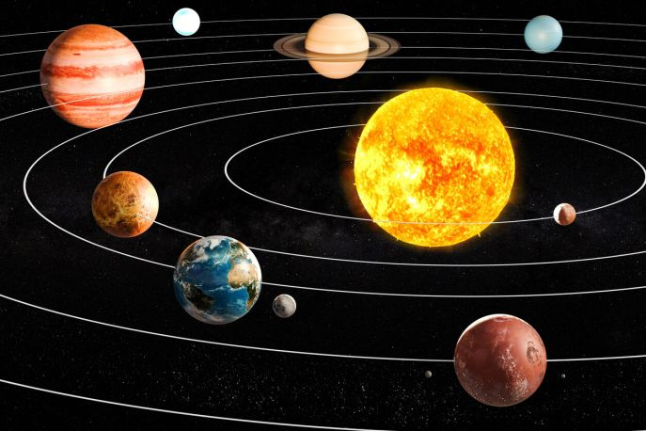
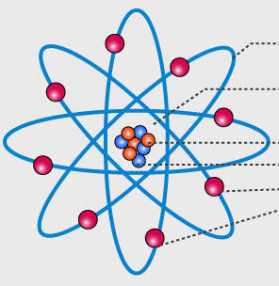
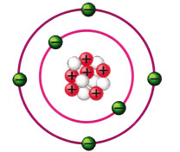
Classical Mechanics
Quantum Mechanics
Explain phenomenon at the macroscopic level.
Explain phenomenon like
Interference
Polarization
Scattering
Reflection
Explain phenomenon at the microscopic level.
Explain phenomenon like
Photoelectric effect
Compton effect
Radioactivity
X- rays

Slide 4
History of Quantum Mechanics
1. Max- Planks Theory (Black Body Radiation) - 1900
2. Einstein ( Photoelectric Effect) -1905
3. De- Broglie( Matter Wave) - 1923
4. Davisson – Germer (Electron Diffraction) -1927
5. Quantum picture
Heisenberg uncertainty
Schrodinger Equation

Slide 5
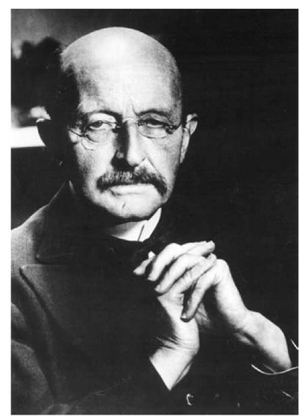
Planck’s quantum hypothesis
The atomic oscillator in a body cannot have any arbitrary amount of energy.
They could have only discrete units of energy given by,
E = nνh
Where,
n - any positive integer = 1,2,3…….
ν - frequency of oscillation
h - Planck's constant
The atomic oscillator cannot absorb or emit energy of any arbitrary amount.
The amount of radiant energy in each unit is a quantum of energy.
Each quantum carries an energy, E = h ν
These particles possess a fixed amount of energy given by E=h ν , are called as photons.
Max Planck

Slide 6
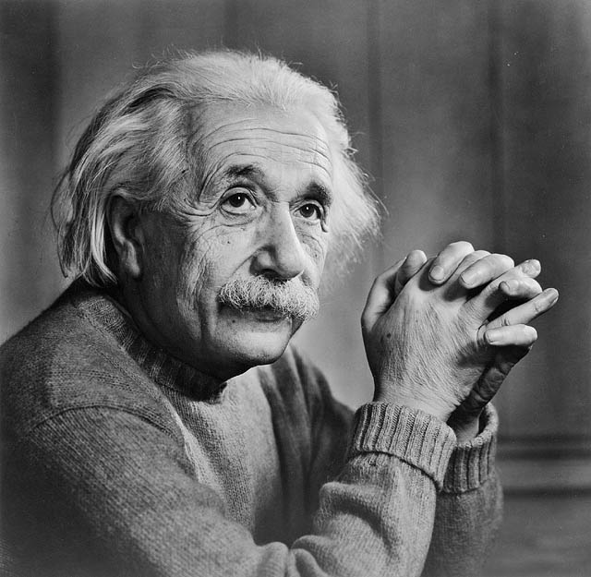
Photoelectric Effect
The phenomenon of emission of electrons from a substance, when exposed to light or any other radiation of suitable wavelength or frequency is called photoelectric effect.
The electrons emitted are called photoelectrons.
Albert Einstein

Slide 7
Properties of photons
Energy – The energy of a photon is given by E= h ν.
Velocity – Photons always travel with the velocity of light c.
Rest mass – Rest mass of photons is zero, since photon can never be at rest.
Electric charge – Photons are electrically neutral, so cannot have any effect of electric and magnetic field.
Linear momentum – p = E/c = h ν /c = h/λ

Slide 8
Wave Particle duality of light
In some phenomenon light behaves as a stream of particles, in other phenomenon it behave as an electromagnetic wave, light possess both particle and wave nature i. e dual nature which is known as wave particle duality of light.
LIGHT
PARTICLE
WAVE 0

Slide 9
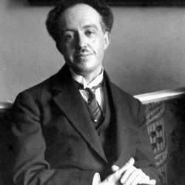
De- Broglie’s Hypothesis
(The Central part of Quantum Mechanics)
In 1924, Louis de Broglie state that Dual nature need not be a special feature of light, but also dual nature of material particles or matter.
Any moving particle is associated with wave. the wave associated
with moving particles are known as de Broglie wave or matter wave.
The wavelength of de Broglie wave,
λ = h/p = h/m v
Where,
h – Planck's constant
p – momentum of particle
De- Broglie

Slide 10
A wave is associated with every moving material particles are known as de Broglie waves or matter waves
λ
De Broglie wavelength
De Broglie wavelength of an electron
λ = h/p = h/mv
12.26 Å
λ =
V
De Broglie wavelength in terms of kinetic energy
h
λ =
2mE

Slide 11
Relation between de-Broglie wavelength & Energy
Momentum
Velocity
λ =
h
h
λ =
P
m v
Energy
Potential difference
But P =
But E = e V
2mE
h
h
λ =
λ =
2meV
2mE
For electron
12.26 Å
λ =
V

Slide 12
Important conclusions
λ ∞ when velocity of particle is zero. It means that matter waves are detectable only for moving particles.
Lighter the particle, smaller the value of mass m hence longer is the wavelength of matter wave associated with it. Therefore wave behavior of micro particles will be significant.
The smaller the velocity of the micro particle, the longer is the wavelength of the matter wave associated with it.
For macro bodies, mass is very large and hence matter waves generated by them will have very small values of λ, which can not be detected.

Slide 13
De- Broglie waves are insignificant in case of macro- bodies
A/C to Broglie hypothesis a moving body is associated with matter waves and wavelength of the wave is λ.
λ = h/p = h/m v
Where,
m = mass of the body
v = velocity of the body
As the mass of the body increases, wavelength tends to be insignificant. therefore wavelength of macroscopic bodies become insignificant in comparison to the size of the bodies themselves even at very low velocities.
In case of microscopic particles, m is small and at low velocity, the wavelength will be longer and significant and hence the wave nature becomes perceptible.

Slide 14
Q. 1.Calculate de- Broglie wavelength associated with an electron moving with an energy of 100 eV.
ANS =
h
λ =
2mE
ANS = 1.22 A°

Slide 22
Q. 2.Calculate wavelength associated with 1 MeV proton.
ANS =

Slide 23
Q.3. Calculate the de Broglie wavelength of the orbital electron of hydrogen atom given that its energy is 13.6 ev.
ANS =

Slide 25
Q.4. Determine the velocity and kinetic energy of a neutron if de-Broglie wavelength 1 A (mass of neutron = 1.67 X 10⁻²⁷kg)
ANS =

Slide 27
Q.5. A proton and α- particle are accelerated by the same potential difference. Show that the ratio of the De- Broglie wavelengths associated with them is 2√2. Assume the mass of alpha particle to be 4 times the mass of proton.
ANS =

Slide 29
Q.6 . Using De- Broglie hypothesis, calculate the wavelength associate with a stone of mass 50gm moving with speed of 50m/s and an electron with kinetic energy of 100 eV.
ANS =

Slide 31
Q.7. A bullet of mass 40 gm and an electron both travel with a velocity of 1000 m/sec . What wavelengths can be associated with them ? Why is the wave nature of bullet not revealed through diffraction effect ?
ANS -

Slide 33
Q.8. Calculate the following De - Broglie wavelength of
1.150 gm base ball moving with 35m/s
2. Electron accelerated through 120 V.
What inference can be drawn from this result ?
ANS -

Slide 35
Q.9. An electron beam is accelerated from rest through a potential difference of 200 V. calculate the associated wavelength.
ANS -

Slide 37
Q.10. Calculate de Broglie wavelength of an electron moving with velocity of
ANS -

Slide 40

Bohr’s quantization condition of angular momentum using de-broglie hypothesis
A/c to bohr’s atomic model,
L = mvr = nh/ 2 𝜫 ………………..1
Electron is moving in the orbit, the wave associated with it will travel along the circumference of the circle. the wavelength of the wave is,
λ = h/p = h/m v …………………2
As electron is revolving repeatedly in the orbit, after completion of one circle, the wave associated with moving electron makes standing wave.
The condition for an electron to stay in a orbit is that distance traveled by electron in one revolution equal to wavelength of wave associated with electron.
2 𝜫 r = λ
2 𝜫 r = 2λ

Slide 41
2 𝜫 r = 3λ
2 𝜫 r = nλ …………………3
n=1, 2, 3, 4……
Thus ,we get the same condition of angular momentum for an electron to stay in n th orbit, using de Broglie relation.
Thus, bohr’s atomic model is justified on the basis of de Broglie hypothesis.

Slide 42
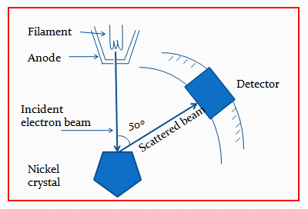
Davisson-Germer Experiment
Experimental proof for De- Broglie Hypothesis (1927)

Slide 43
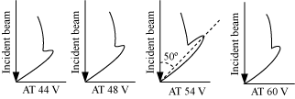
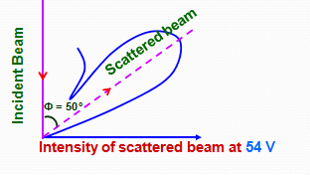
Explanation
Intensity of scattered beam of electrons is found to be maximum when angle of scattering is 50° and the accelerating potential is 54 V.

Slide 44
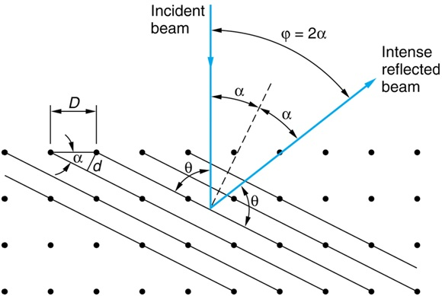
Analysis

Slide 45
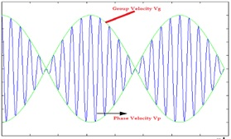
Wave Packets
A wave is always characterized by its infinite spread in space while particle has precise location.
Energy of wave is spread over region of its existence since its amplitude is same everywhere but, energy of particle is concentrated at its site. Thus, a single monochromatic wave does not represent a localized particle.
A single wave cannot represent a particle and hence many waves representing a particle has to be considered, giving rise to the concept of wave packet.
It is a resultant of combination of infinite number of waves having almost the same amplitude but wavelengths slightly different from one another.
Matter waves can be represented by a wave packet.

Slide 46
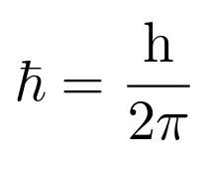
Heisenberg Uncertainty Principle
Statement-
The measurement of momentum and determination of location of a micro body can not be done simultaneously with 100 % accuracy.
OR
It is not possible to determine simultaneously the measurements of position and momentum of a particle to an unlimited accuracy.
OR
Heisenberg’s uncertainty principle states that, the momentum and position of a particle cannot be measured accurately and simultaneously.
The product of uncertainty in position and momentum of a particle is greater or equal to h/2 𝜫
^{where h is Planck’s constant.}
Heisenberg’s Principle is written mathematically as
^{Δx .Δp > h/2 𝜫}

Slide 47
Physical Significance
Simultaneous determination of momentum and location of the moving micro bodies can not be measured with 100% accuracy.
If we try to reduce the error in measurement of one parameter, the error in measurement of another parameter increases by the same amount.
If one parameter is measured with 100% accuracy, the error in measurement of another parameter becomes infinite.

Slide 48
Application of Heisenberg Uncertainty Principle
To prove electron do not exist inside the nucleus of an atom
Let an electron exists in the nucleus then it may be found anywhere in the nucleus. Hence the uncertainty in the position of electron is equal to the diameter of nucleus.
^{Diameter of nucleus is}
^{Δ x =}
Using Heisenberg’s uncertainties principle uncertainty in momentum can be found as
^{Δ x .Δ p > h/2 𝜫}
^{Δ p =}
^{Δ p =}
This can be considered as the maximum momentum possessed by electron.
From this value of p, the energy of electron is calculated as
^{E = p.c}

Slide 49
Q.1. The position and momentum of 1keV electrons are simultaneously determined. If its position is located within 1 Å, what is the percentage of uncertainty in its momentum.
ANS -

Slide 50
Q.2. The speed of an electron is measured to be 5 m/s to an accuracy of 0.003%. Find the uncertainty in the position of electron.
ANS -

Slide 51
Q.3. An electron and a 150 gm base ball are travelling with velocity 220 m/s , measured to an accuracy of 0.005%. Calculate and compare uncertainty in position of each.
ANS -

Slide 52
Q.4. Compute the minimum uncertainty in the location of a body having mass of 2 gm moving with a speed of 1.5 m/s and the minimum uncertainty in the location of electron moving with the speed of 0.5 m/s.
Given –
^{Δ p =}
^{P}
ANS -

Slide 53
Q.5. a proton is confined to a nucleus of radius m. calculate minimum uncertainty in its momentum . Also calculate the minimum uncertainty in velocity of the proton. The mass of the proton is 1.67 kg .
ANS -

Slide 54
Q.6. An electron and bullet (mass = 50 gm) are travelling with the same velocity of 300m/sec. assuming an accuracy of 0.01% in velocity measurement, calculate the accuracy in location of their positions. What inference can be drawn from this result.
ANS -

Slide 55
Wave Function
A mathematical function used in quantum mechanics to describe the propagation of the wave associated with a particle is called wave function.
The wave function mathematically describes the motion of an electron.
^{Wave function is denoted by 𝜳.}
It depends on position of system (x, y, ^{z) and of time (t).}
In general it is a complex quantity.
It does not have direct physical significance as it is not observable quantity.
complex conjugate of wave function is 𝜳∗

Slide 56
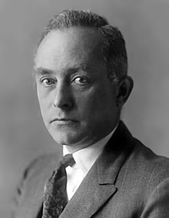
Physical Significance of wave function
It gives the probability of finding the particle in a particular region. The actual probability of finding the particle in a particular region is given by the product of the wave function with its complex conjugate.
∫Ψ.Ψ* d v = ∫⏐Ψ⏐² d v
^{Where,}
^{dv -} probability of finding the particle in a small volume = dxdydz
∫⏐Ψ⏐2 - is called probability density
^{Ψ -} ^{the probability amplitude.}
Max Born
It must be single valued for each set of values of x, y, z. it must have only one value.
It must be finite value. Since it gives probability of finding the particle in a particular region, it cannot have infinite value.

Slide 57
It must be continuous function in all regions since it represents a real particle, it cannot have discontinuity across the boundary.
Its partial derivatives must be continuous.
Normalized wave function is
∫⏐Ψ⏐² = 1 or
∫⏐Ψ⏐² = 1 indicates the presence of the particle at that point, at time t.
∫⏐Ψ⏐² = 0 indicates the absence of the particle at that point, at time t.
Normalized wave function means 𝜳 represents a particle which is certainly found somewhere in space. Total probability of finding particle somewhere in space at all time is unity.
^{∫ΨΨ* dv = 1}

Slide 58
Well behaved Wave function
The wave function 𝜳 which represents a moving particle, should satisfy the following condition
𝜳 Should be single valued – The wave function should be single valued at any point.
𝜳 Must be finite - It must remain finite for all values of x, y, z.
𝜳 Must be continuous – The wave function and its derivatives should be continuous across any boundary.
The wave functions satisfying the above mathematical conditions are called well behaved wave function.

